Slide 1
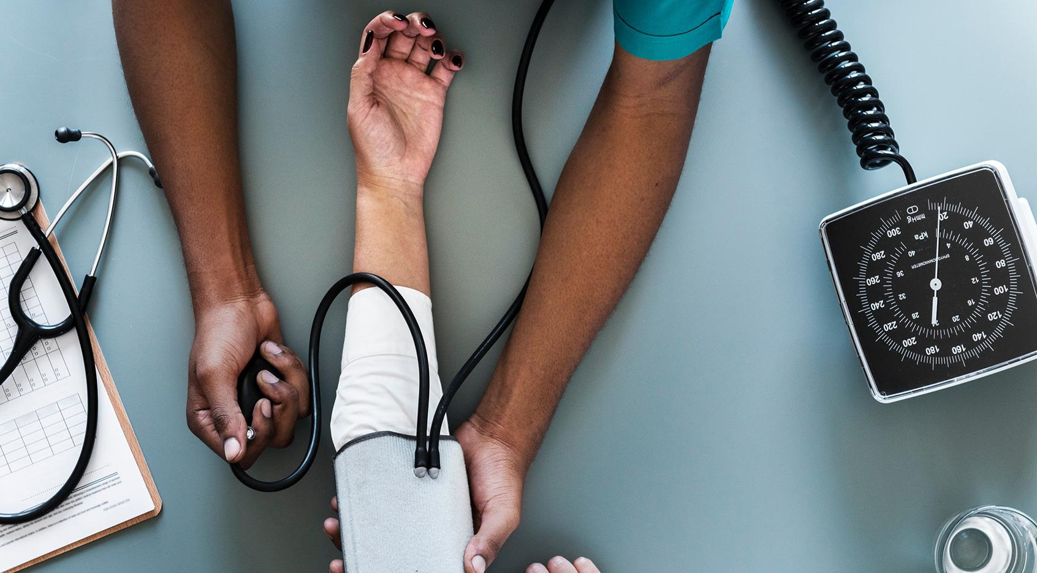
HEALTHCARE
“The first wealth is health”
Ralph Waldo Emerson
U.S poet and essayist (1830 – 1882)

Slide 2
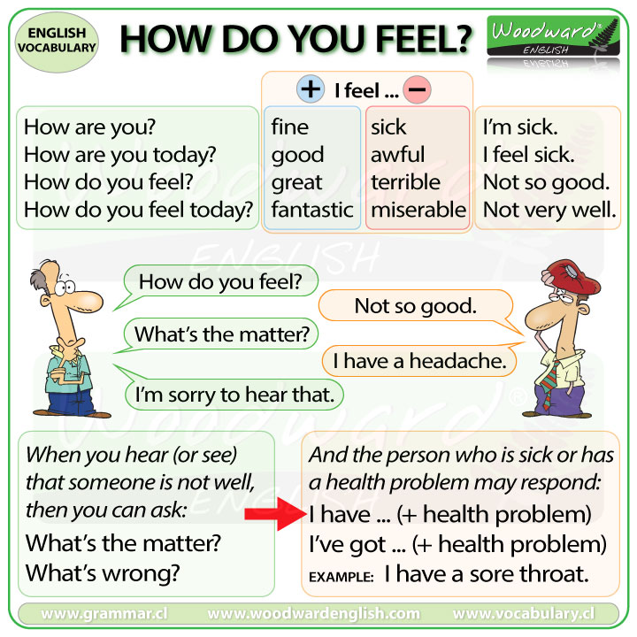

Slide 3
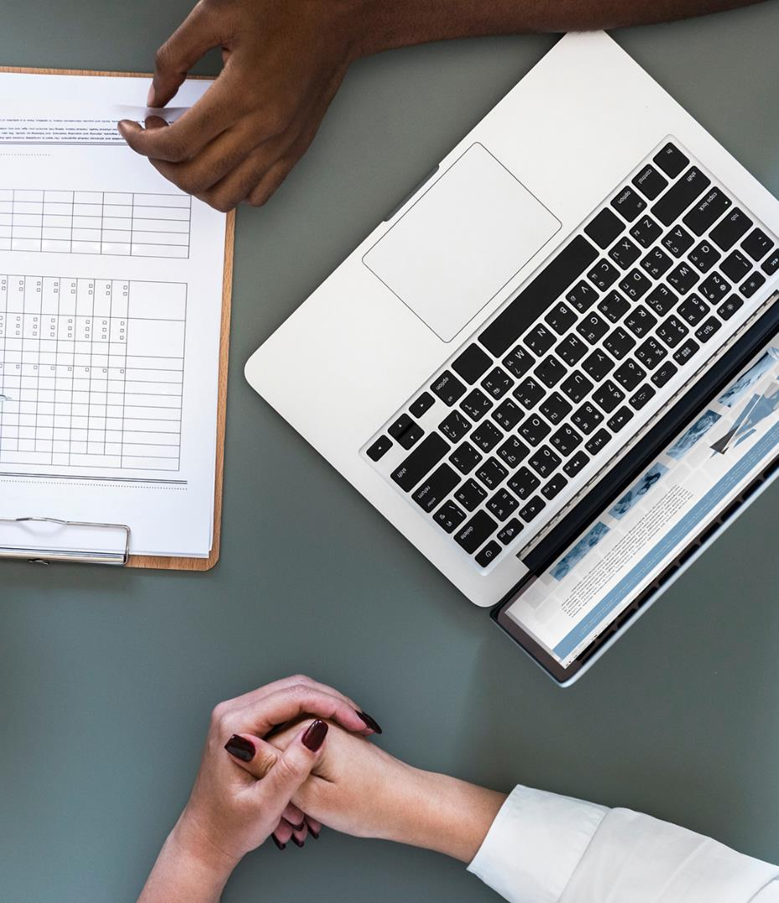
Calling a Hospital
How often do you catch a cold? In October
How often do you get a flu?
How often do you go to a clinic or hospital to see a doctor? Every 6 months
When did you see a doctor most recently?
Where and why did you see a doctor?
Does your school have a student health clinic?
A hospital has many service. Describe the following services:
A 24 hour pharmacy (drug store)
An ER (emergency room)
Family Medicine
What is medical insurance?
Why do people need medical insurance?
What kind of insurance do you have(e.g, car, medical, home, life)?
Ask and answer the question

Slide 4
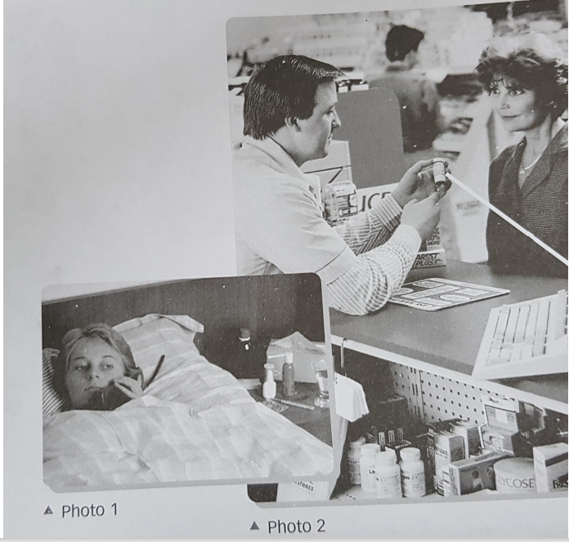
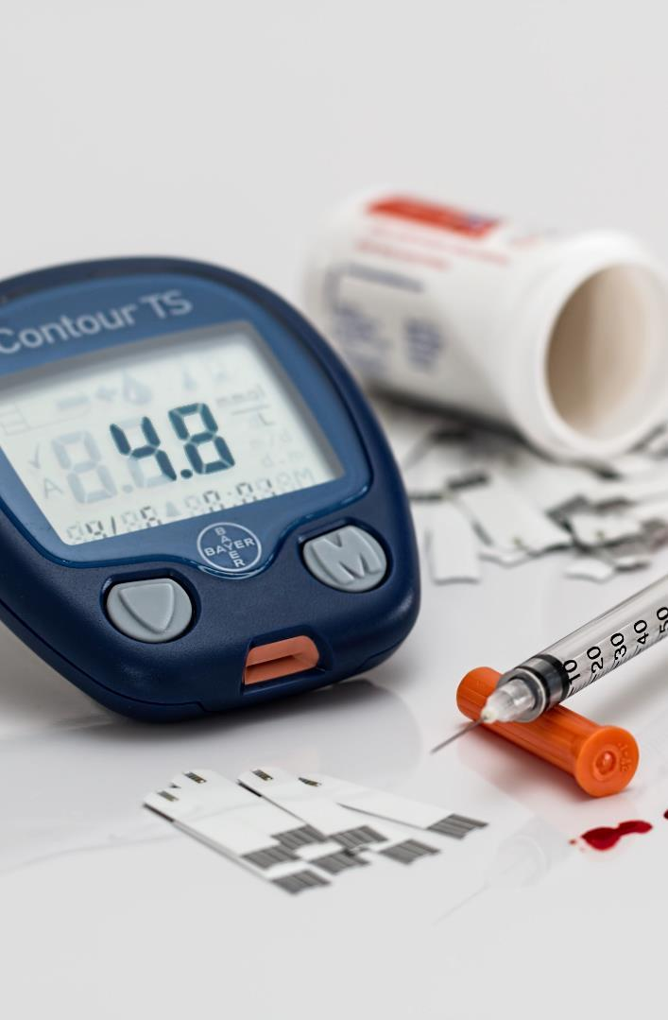
Answer the questions below
Go to see the doctor
What’s the matter with 2 women in photos?
In what ways are they different from each other?
In your opinion, whose condition is worse? Why?
Stay in bed, make an appointment

Slide 5
COUGH MEDICINE
Decide whether the statements below are TRUE (T) or FALSE (F)
Cough medicine is prescribed for a person who got a sore throat. _________
Patients could be fine if they take 9 capsules a day. _________
Cough medicine is not dangerous for adults and children over 12 years old. _________
Every 6 hours, patients are allowed to take 2 capsules. _________
When medicine is not used, it should be kept at 30˚C. _________
T
Indication:
Temporarily relieves cough due to minor throat and bronchial irritation as may occur with a cold.
Directions:
Do not take more than 8 capsules in any 24-hour period.
Adult and children 12 years and over:
Take 2 capsules every 6 to 8 hours, as needed.
Children under 12 years: Ask a doctor.
Store at 68-77˚F (20-25˚C). Avoid excessive heat above 104˚F (40˚C). Protect from light.
F
T
T
F

Slide 6
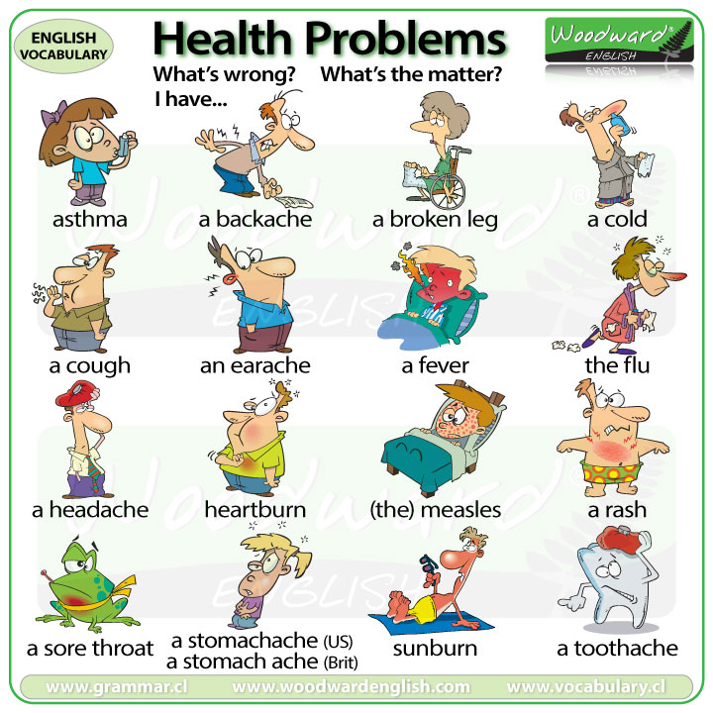

Slide 7
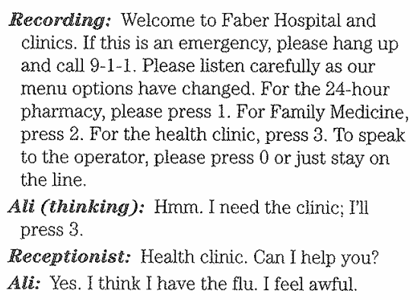

Listening for the Main Ideas
Listen to the first part of Ali’s phone call. Choose the best answer to each question.
What is Ali listening to at first?
The hospital menu options
The hospital operator
The clinic doctor
2. If this were an emergency, what should Ali do?
Press “1”
Hang up and call 9-1-1
Call the health clinic
3. Who does Ali talk to?
Someone at the pharmacy
Someone in “Family Medicine”
Someone at the health clinic

Slide 8
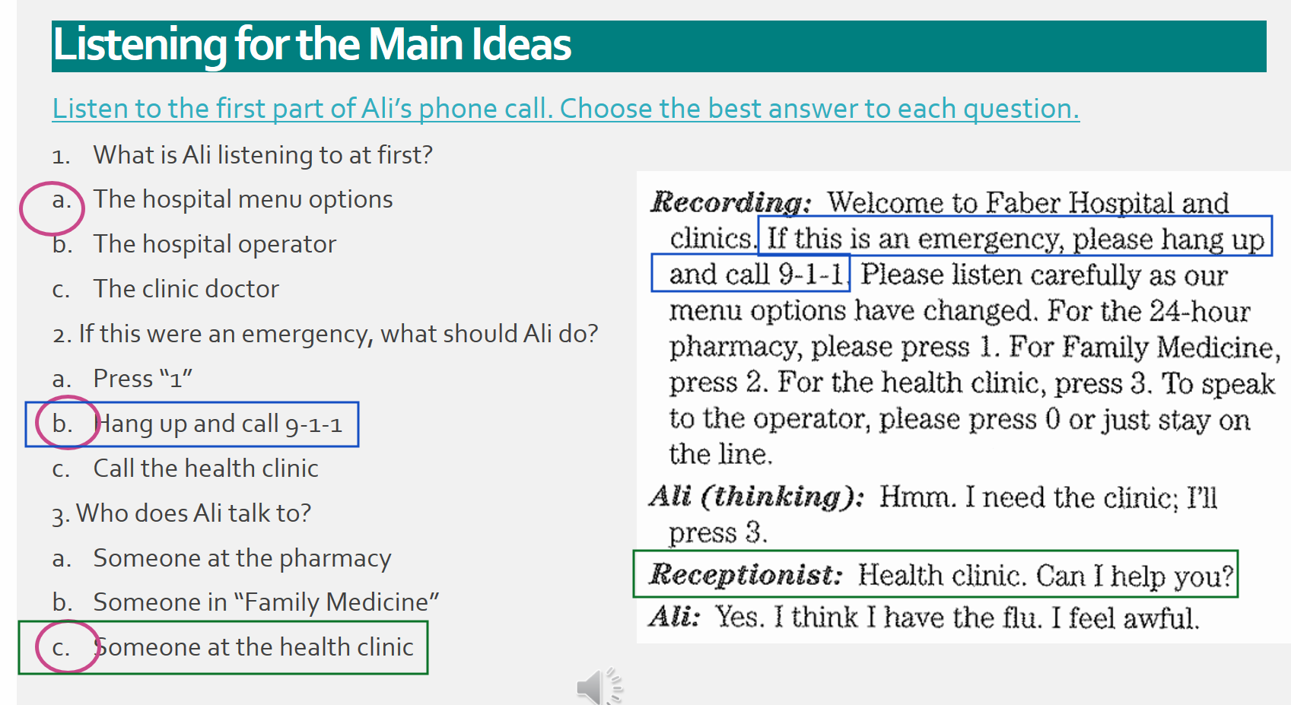

Slide 9
Listening for the Main Ideas
Listen to whole phone call. Choose the best answer to each question.
What does Ali do after he listens to the menu options?
He presses “1” for the 24 hour pharmacy
He presses “2” for Family Medicine
He presses “3” for the health clinic
2. Why is Ali calling the health clinic?
He thinks he has the flu
He wants to make an appointment to see a doctor.
Both a and b
3. What should Ali bring to the appointment?
His student ID and the health insurance card
Some money
Both a and b

Slide 10
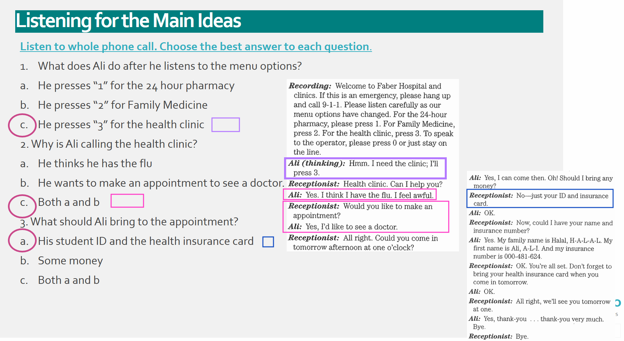

Slide 11
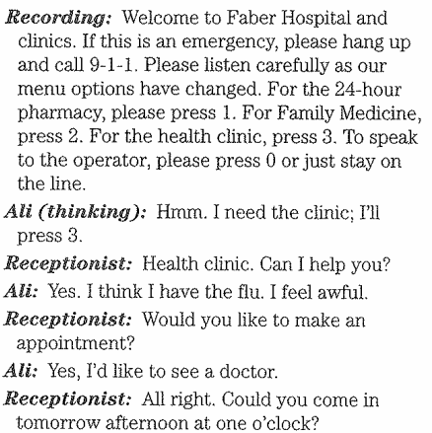
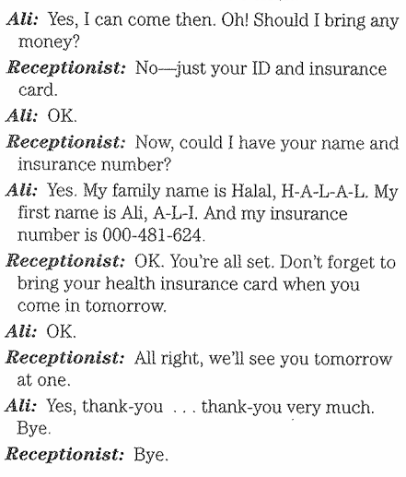
Listening for Specific Information
Listen to Ali’s phone call. Choose the best answer
When is Ali’s appointment?
This afternoon at one o’clock
Tomorrow afternoon at one o’clock
The day after tomorrow at one o’clock
2. Ali says, “I’d like to see a doctor.” What does the clinic receptionist say?
“All right. Come in tomorrow afternoon at one o’clock.”
“All right. You should come in tomorrow afternoon at one o’clock.”
“All right. Could you come in tomorrow afternoon at one o’clock.”
3. At the end of the conversation, what else does the clinic receptionist remind Ali to bring?
His ID card
His health insurance card
Money

Slide 12
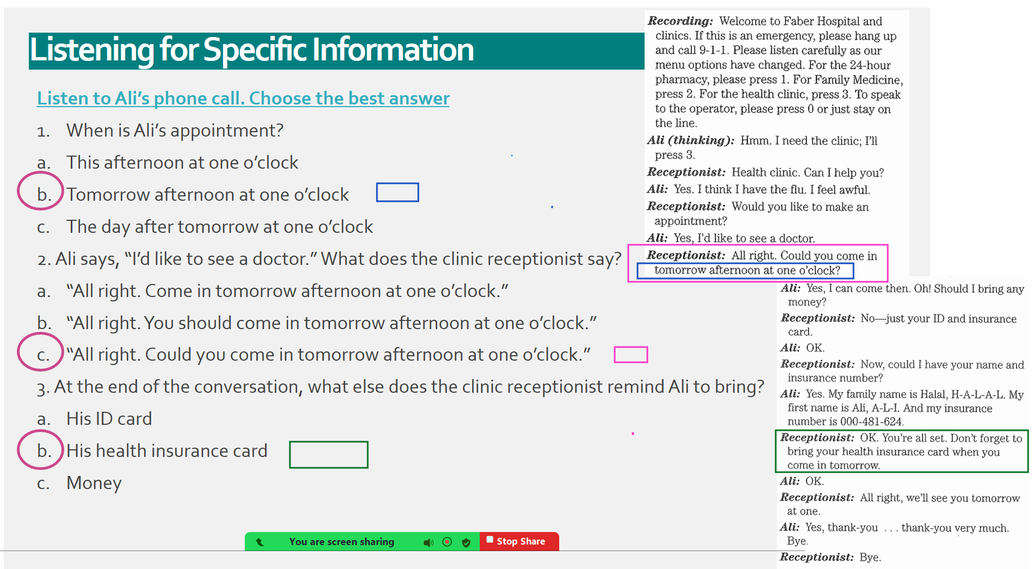

Slide 13
Vocabulary review
emergency | insurance card | menu options | to hang up | the flu
health clinic | ID card | stay on the line | to make an appointment
the flu
Ali’s very sick. He may have _______ ____________ _____ or a cold.
Ali wants ________ ______ _____ ____________ _______ ______ ____ to see a doctor tomorrow.
Here is my ________ ____________ ____. It shows my name and address.
He’s sick. He’s going to the _____ ____________ _______.
He’s going to need his health _____ ____________ _______ when he goes to the clinic.
Ali doesn’t need to call 9-1-1 because it’s not a/an _ ____________ ___________.
Listen carefully to the _______ ____________ _____ before choosing a number.
No one is answering the phone; I’m going ___ ____________ _________ and try to call again.
If you need to speak to the operator; press “0” or just ______ ____________ ______
to make an appointment
ID card
health clinic
insurance card
emergency
menu options
to hang up
stay on the line

Slide 14
Listening for Specific Information
afternoon | bring | flu | insurance | No | think
appointment | card | help | like | Oh | tomorrow
awful | doctor | ID | money | one o’clock | would
Receptionist: Health Clinic. Can I ____________ you?
Ali: Yes, I _______________. I have the _______________. I feel _______________.
Receptionist: _______________ you _______________ to make an _______________?
Ali: Yes, I’d _______________ to see a _______________.
Receptionist: All right. Could you come in _______________ _______________ at _______________.
Ali: Yes, I can come then. _______________ ! Should I _______________ any _______________?
Receptionist: _______________ - just your _______________ and _______________.
help
think
flu
awful
would
like
appointment
like
doctor
tomorrow
afternoon
one o’clock
Oh
bring
money
No
ID
Insurance card

Slide 15
Listening for Reduction
Listen and circle the letter or the sentence that you hear.
1 | a. Can I help you? | b. C’n* I help you?
2. | a. Would you like to make an appointment? | b. Wudja* like to make an appointment?
3 | a. Could you come in tomorrow afternoon at one? | b. Cudja* come in tomorrow afternoon at one?
4 | a. No – Just your ID and insurance card. | b. No – Justcher* ID ‘n* insurance card.

Slide 16
Context clue
3
You will hear five telephone calls. Listen to question for each call: Who is the speaker calling?
Write the number of each call in the blanks below.
_______ The dental clinic
_______ The eye clinic
_______ The fire department
_______ The health clinic
_______ The police department
5
4
1
2

Slide 17
LISTENING TO INSTRUCTION
Do you ever get sick?
What do you do when you are sick?

Slide 18
Listening to Instructions
Nouns
cavity
(dental) cleaning
checkup
(eye) exam
aspirin
(a) cold
drugstore
fever
Verb
take your temperature
ache
cough
sneeze
Adjectives
- stolen

Slide 19
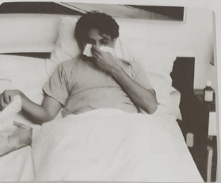
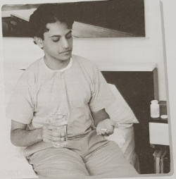
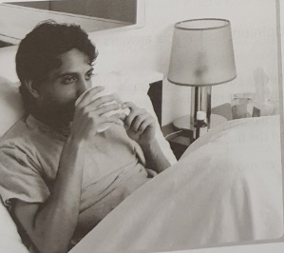
Listening for the Main Idea
Listen to the doctor’s advice. Cross out the incorrect words in the sentence next to each photo.
You should (go to school/ stay in bed) and (exercise/ rest) as much as possible.
You can take (two aspirin/four aspirin) (four times/two times) a day. That will help the fever and the aches and pains.
Be sure to (drink plenty of fluids/ eat plenty of fruits). Fruit juice and (coffee/ hot tea) are the best.
Here’s a prescription for some (cold/ cough) medicine. You can take it to any (department store/ drugstore).
Be sure to take your medicine (when you feel bad/ with your meals) because it might (upset your stomach/ upset your mother.)

Slide 20
Discussing your opinion
Talk about home remedies (things that you make at home to make you feel better). Do you use any home remedies when you get sick?
In your opinion, do herbal remedies (remedies that come from plants) work very well for colds and the flu? Which ones work? How do they help?

Slide 21
LISTENING TO COMPLAINTS
What illnesses and other problems can cause pain?

Slide 22
Listening to Instructions
Nouns
ankle
bandage
headache
Verb
Break (a leg)
Vomit
sprain
Expression
- (an illness) is going around

Slide 23
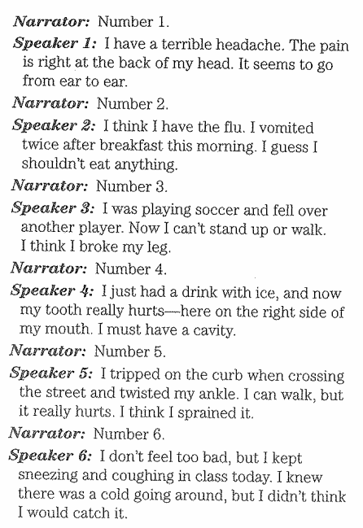
Listening for the Main Idea
Listen to the complaints and answer these questions
How many speakers do we hear?
How many speakers say that they are in pain?
What kind of pain do they have?
There are 6
There are 3
Headache, toothache, ankle twisted,

Slide 24
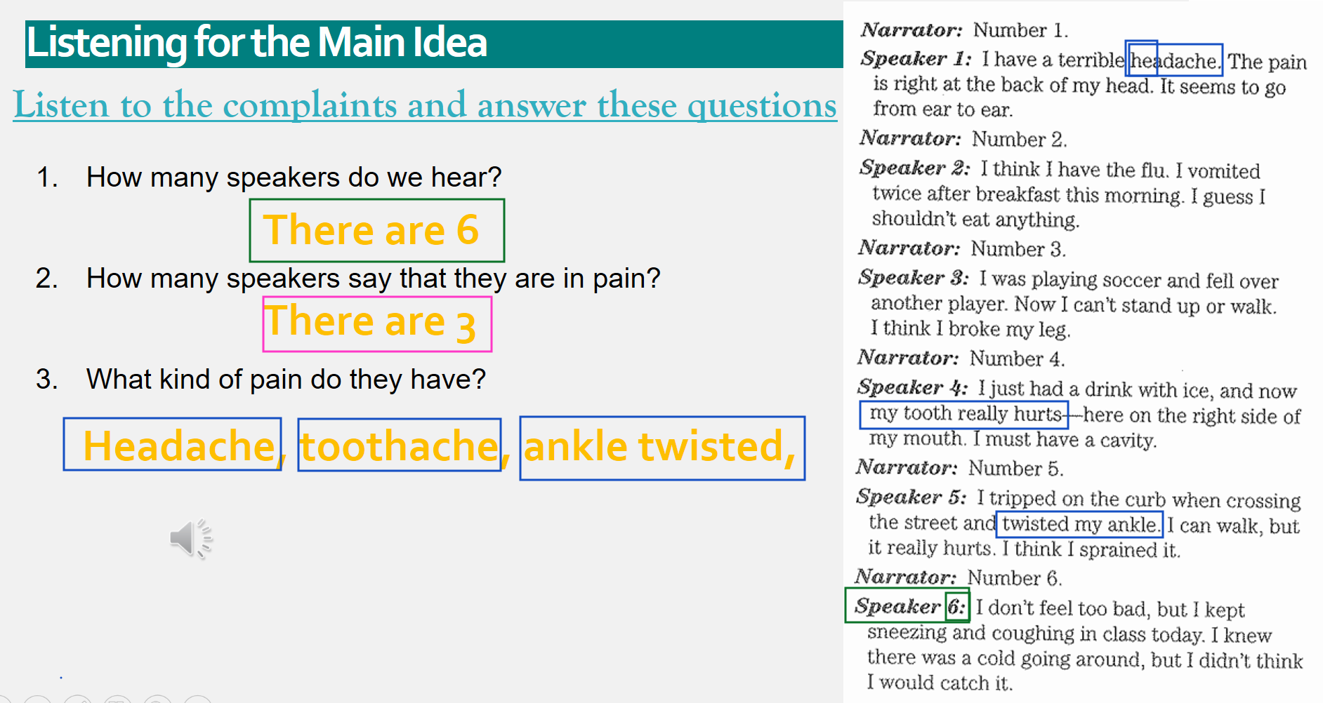

Slide 25
Listening for Specific Information
Listen to the complaints and choose one of the following statements as advice for each speaker. Write the number of the speaker next to the best advice for that speaker’s complaint
4
_______ You should take two aspirin for the pain and see a dentist as soon as possible.
_______ You should wrap a tight bandage around your ankle. Don’t walk on it for a few days.
_______ You can take some medicine from the drugstore for the sneezing and coughing. Drink plenty of fluids and try to rest.
_______ You should take two aspirin. See a doctor if your head still hurts tomorrow.
_______ You should go to a doctor and get an X-ray.
_______ You shouldn’t eat anything for two or three hours – until you stop vomiting. Then you can have clear fluids. If that doesn’t work, see a doctor.
5
6
1
3
2

Slide 26
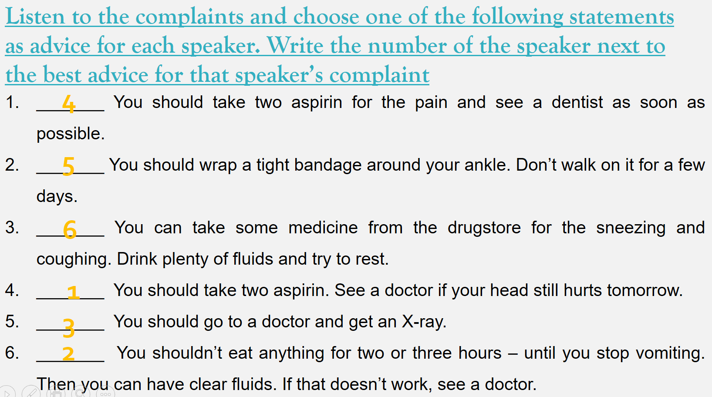

Slide 27
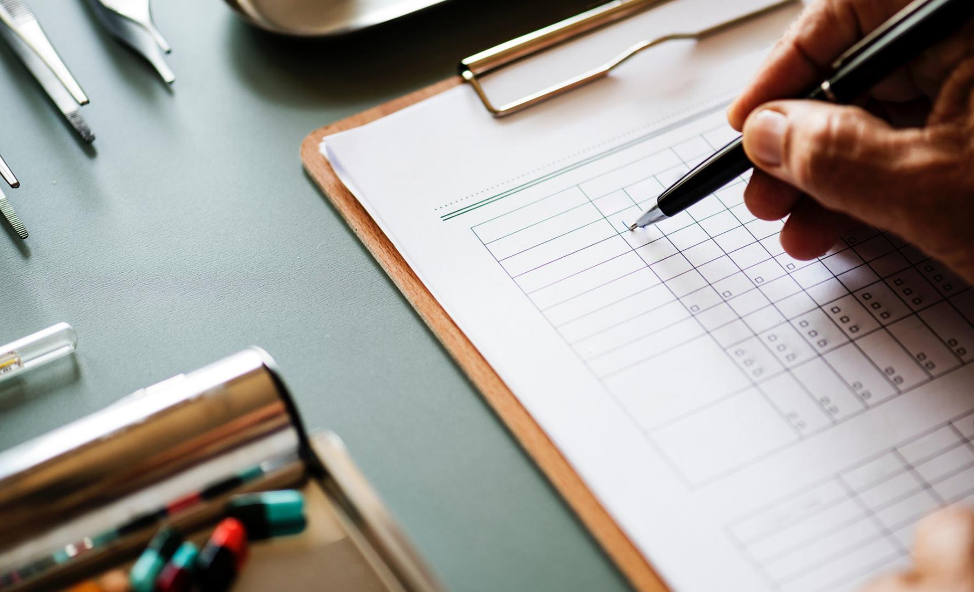
USING LANGUAGE
Giving Advice

Slide 28

USING MODALS TO GIVE ADVICE
Sometimes people tell you their problems and you want to give advice. To do this, you can use modals such as could, might, should, and have to. Use have to for a very strong suggestion. Should is a little less strong. Use could and might when you don’t want to give strong advice.

Slide 29
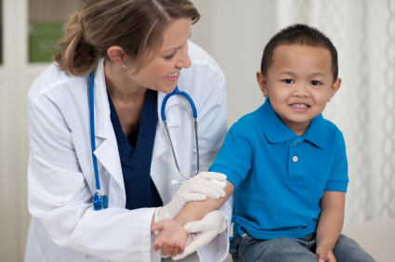
Modal
could might should have to | least strong strongest
Example:
Problem: I’m homesick.
Advice: You could call your family.
You should call your family.
You have to call your family.

Slide 30
Giving advice
Read the given problem and give the advice for each problem
Problem
1- My neighbors are noisy. I can’t sleep.
2- I miss my family and friends at home.
3- I’m afraid to speak English outside of class.
4- My roommate/ boyfriend/girlfriend watches TV all the time.
5- I never have enough money.
Advice Expressions
You should _________.
You could _________.
You might _________.
You have to _________.
You don’t have to _________.

Slide 31
Discussing questions
What do you do when you have a cold? Drink hot ginger tea with honey.
What special foods do you eat? What special drinks do you have?
Porridge/ vegetables/ hot tea with ginger/ honey tea. (fridge)
3. What advice does your mother give you? You only live once. Do whatever you like. Keep V-ing Keep talking
4. Do you exercise or play a sport? Yes. I usually do rope skipping, weightlifting
5. Are you at the right weight? I guess, I gain a little weight in this period.
6. Do you smoke? I don’t do it. It’s unhealthy habit.

Slide 32
Do you get at least eight hours of sleep every night? Yes, I usually get sleep deprived.
Do you eat fruits and vegetables everyday?
Of course. They are beneficial for your health and your body/ mind
3. What is your biggest health worry?
Honestly, I sleep very late at night and get tired when I wake up.
I am a workaholic and get busy everyday. Sometimes, I skip breakfast/ lunch to spend time for work. This habit damages my stomach. It hurts sometimes.

Slide 33


Thank You

